Slide 1
American Sign Language Recognition Using Hand Gestures
Presented By: - Shadab Shaikh
Obaid Kazi
Mohd Adnan Ansari

Slide 2
Outline
Introduction
Motivation
Problem statement
Applicability of this project
Practical application
Features
Technologies used
Working
Conclusion & future scope

Slide 3
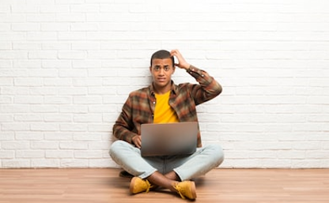
Introduction.
Motivation
A person with speaking disorders face major problems of expressing their emotions as freely in this world.
“Not able to utilize” some of the new technologies.

Slide 4
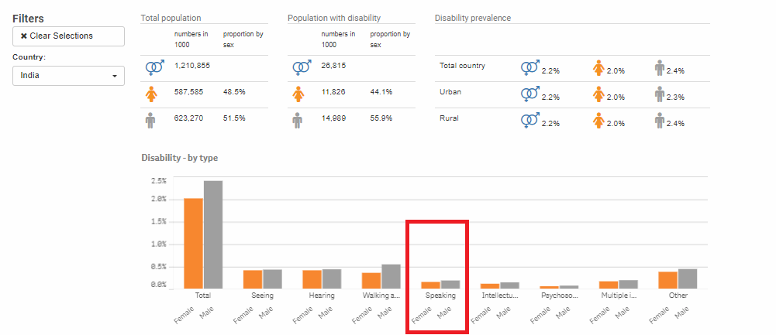
Statistics retrieved from United Nation Statistics Division

Slide 5
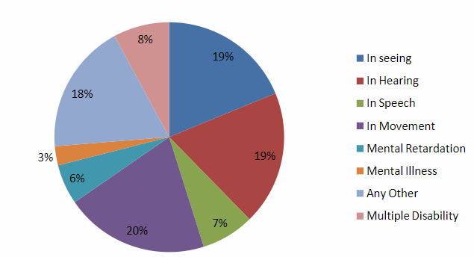
Disabled population by type of disability in India census 2011

Slide 6
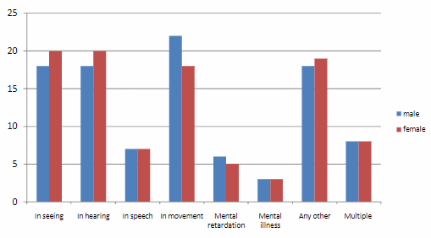
Distribution disabled person by sex and by type of disability (%) in India Census 2011

Slide 7
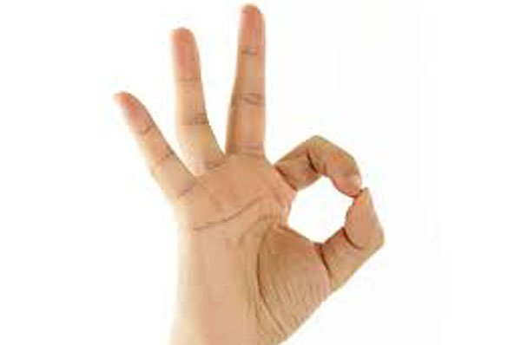
Problem Statement
Given a hand gesture, implementing such an application which detects pre-defined American sign language (ASL) in a real time through hand gestures and providing facility for the user to be able to store the result of the character detected in a txt file, also allowing such users to build their customized gesture so that the problems faced by persons who aren’t able to talk vocally can be accommodated with technological assistance and the barrier of expressing can be overshadowed.

Slide 8
Outline
Introduction
Motivation
Problem statement
Applicability of this project
Practical Application
Features
Technologies used
Working
Conclusion & future scope

Slide 9
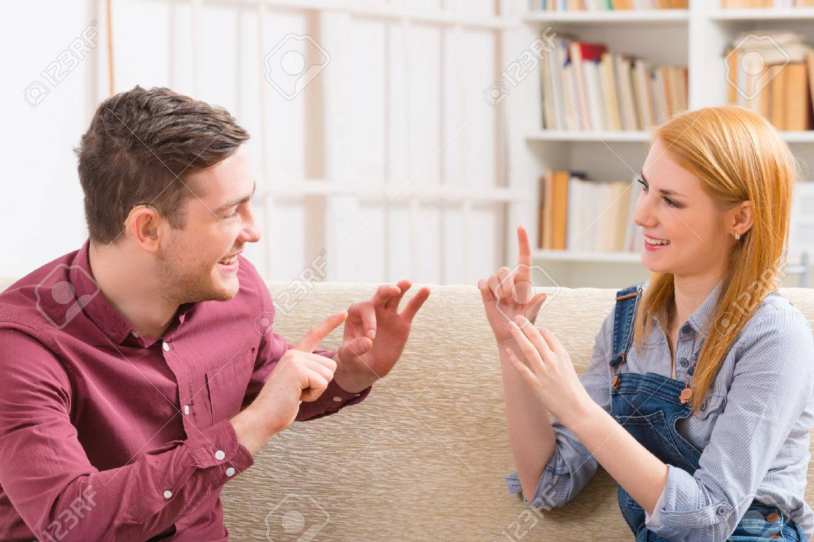
Practical application
Serves the person who wants to learn and talk in sign languages
A user need not be a literate person

Slide 10
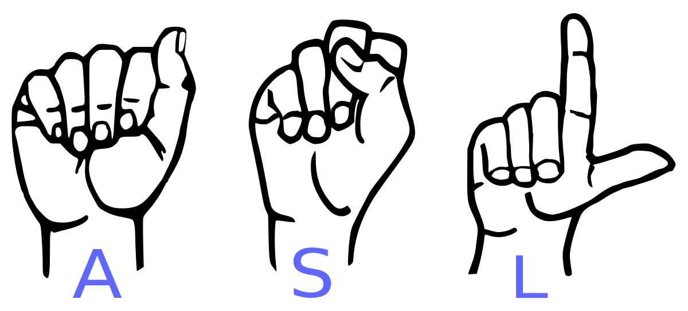
Features of this application
Real time (ASL) detection based on gesture made by user.
Customized gesture generation.
Forming a stream of sentences.
TTS assistance mechanisms concerning to the illiterate people.

Slide 11

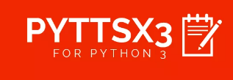





Technologies Used
Python 3.6.
TensorFlow framework, Keras API
Real-time computer vision using OpenCV
Industrial standard GUI application (PyQT5), Tkinter.
Offline TTS assistance for python (pyttsx3 lib)

Slide 12
Outline
Introduction
Motivation
Problem statement
Applicability of this project
Practical Application
Features
Technologies used
Working
Conclusion & future scope

Slide 13
Core Modules
Data Pre-Processing
Scan Single Gesture
Create gesture
Formation of sentence
Exporting

Slide 14
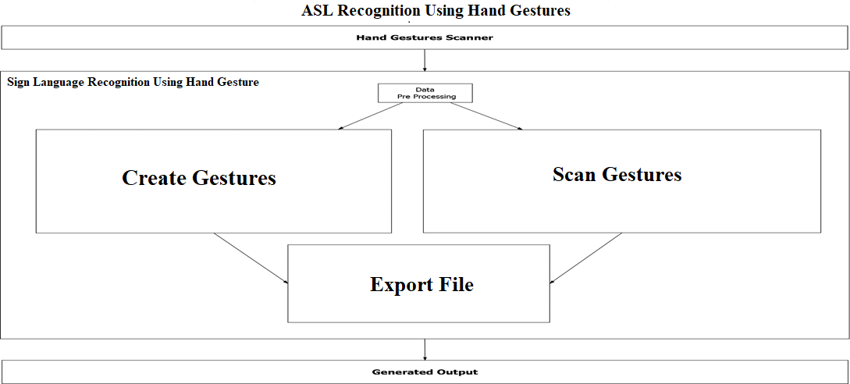

Slide 15
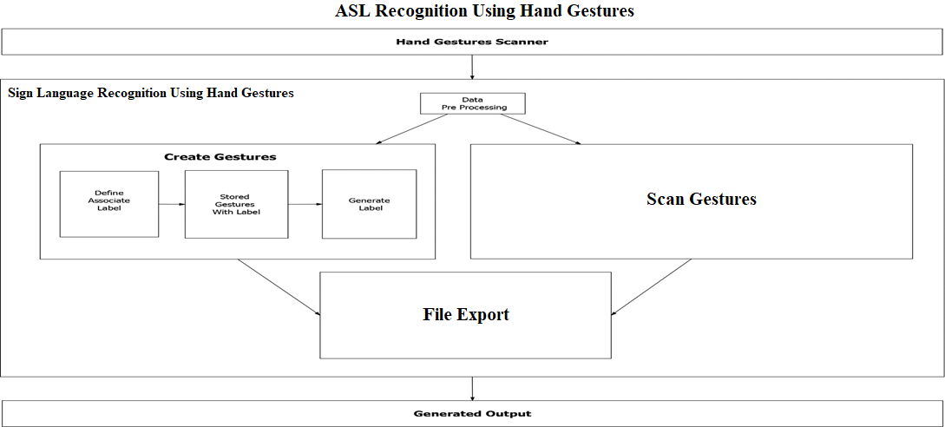

Slide 16
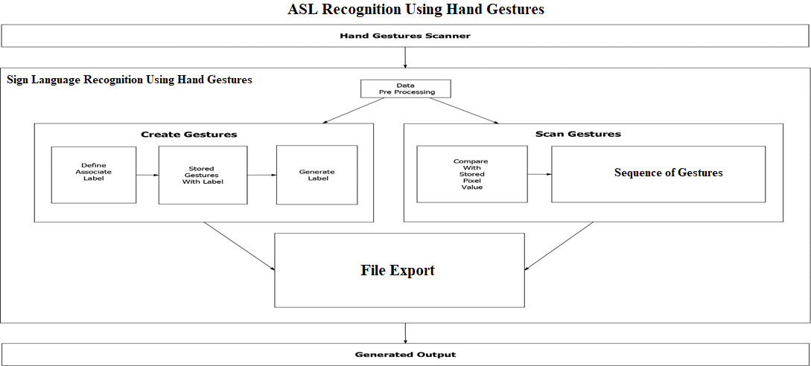


Slide 17
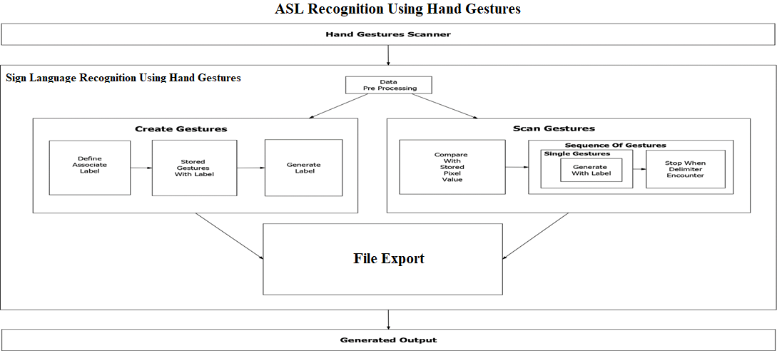

Slide 18
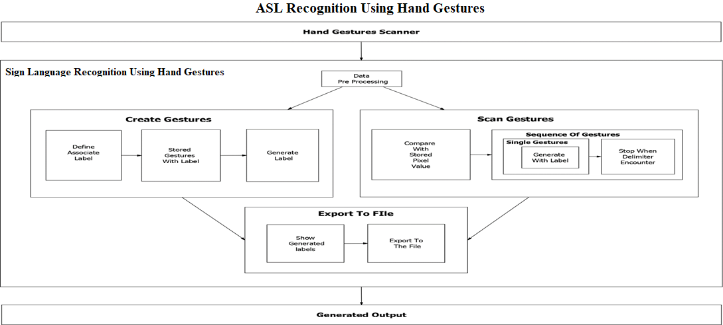


Slide 19
Outline
Introduction
Motivation
Problem statement
Applicability of this project
Practical application
Features
Technologies used
Working
Conclusion & future scope

Slide 20
Conclusion
Overshadowing some of the major problems faced by the persons having speech disorders.
They can quickly learn what alphabet is assigned to which gesture with this application.
Add-on to this custom gesture facility is also provided along with sentence formation.

Slide 21
Future Scope
Integration to search engines and texting application.
Detection of motion video sequence with TTS assistance.

Slide 22
Outline
Introduction
Motivation
Problem statement
Applicability of this project
Practical application
Features
Technologies used
Working
Conclusion & future scope

Slide 23
References
http://mospi.nic.in/sites/default/files/publication_reports/Disabled_persons_in_India_2016.pdf
https://www.quora.com/What-are-some-problems-faced-by-deaf-and-dumb-people-whileusing-todays-common-tech-like-phones-and-PCs
https://www.nidcd.nih.gov/health/american-sign-language

